Slide 1


Slide 2
Data Analysis in IoT
Presented to:
Ms. P. Sheeba Ranjini, AP/S&H
Presented by:
Gunaseelan
Divakar
Hariselvasudhan
Dharshana
Dharshini

Slide 3
Contents
Introduction to IoT
Data in IoT
Types of Data Analytics Used in IoT
Importance of Data Analysis in IoT
Technologies Used in IoT Data Analysis
Real-Life Applications of IoT Data Analysis
Challenges in IoT Data Analysis
Trends in IoT Data Analysis
Conclusion

Slide 4
Introduction to IoT
IoT (Internet of Things) refers to a network of interconnected devices that collect and exchange data.
Examples: Smart thermostats, fitness trackers, industrial machinery with sensors.
Relevance: IoT is transforming industries like healthcare, manufacturing, agriculture, and smart cities by enhancing automation, real-time monitoring, and decision-making.
Key Point: The core of IoT is its ability to generate and analyze vast amounts of data, which is crucial for smart decision-making

Slide 5
Data in IoT
Data Types: IoT devices generate various types of data such as:
Sensor data: Temperature, humidity, motion
Device data: Status updates, usage patterns
Data Characteristics:
Volume: Billions of devices generate enormous amounts of data.
Velocity: Data streams are continuous and often in real-time.
Variety: Data is structured, unstructured, and semi-structured.
Challenges: Handling, storing, and processing such vast, high-speed data streams requires advanced analytics tools and technologies.

Slide 6
Types of Data Analytics Used in IoT
Descriptive Analytics:
Purpose: To understand past events by analyzing historical data.
Example: Reviewing energy consumption trends from smart meters over the last month.
Diagnostic Analytics:
Purpose: To determine the root cause of a problem or anomaly in the data.
Example: Analyzing why a certain device (e.g., a sensor or smart machine) failed by examining system logs and performance data.
Predictive Analytics:
Purpose: To forecast future events based on historical data.
Example: Predicting equipment failure in a smart factory using machine learning models trained on past maintenance records.
Prescriptive Analytics:
Purpose: To suggest possible courses of action to optimize outcomes.
Example: Offering recommendations for adjusting manufacturing processes to improve efficiency based on real-time sensor inputs.

Slide 7
Importance of Data Analysis in IoT
Data analysis in IoT is essential for deriving actionable insights from raw data.
Benefits:
Predictive Maintenance: Predicting failures in machines before they occur, reducing downtime.
Optimization: Improving resource usage and energy efficiency, such as adjusting HVAC systems based on data from smart sensors.
Use Cases:
Smart Cities: Traffic control, waste management, energy optimization.
Healthcare: Monitoring patient health remotely, alerting doctors in emergencies.

Slide 8
Technologies Used in IoT Data Analysis
Big Data Platforms:
Hadoop: Distributed storage and processing of large datasets.
Apache Spark: Real-time processing of big data.
Cloud Computing:
AWS IoT and Microsoft Azure IoT provide infrastructure for IoT data collection and analysis.
Machine Learning (ML) and Artificial Intelligence (AI):
Using ML models to detect patterns, make predictions, and optimize systems in real-time.

Slide 9
Real-Life Applications of IoT Data Analysis
Smart Homes:
Data from connected devices like thermostats and lighting systems is analyzed to optimize energy use, improve comfort, and enhance security.
Healthcare:
Wearable devices like smartwatches monitor vital signs, providing real-time data that helps doctors monitor patient health remotely.
Industrial IoT (IIoT):
IoT data from machines on factory floors can be analyzed to prevent breakdowns and optimize the supply chain for faster production.

Slide 10
Challenges in IoT Data Analysis
Data Privacy and Security: IoT devices collect sensitive data that could be vulnerable to hacking or misuse.
Integration Issues: IoT devices often use different protocols and standards, making it difficult to integrate data across systems.
Scalability: Managing and processing large volumes of real-time data can strain infrastructure and resources.

Slide 11
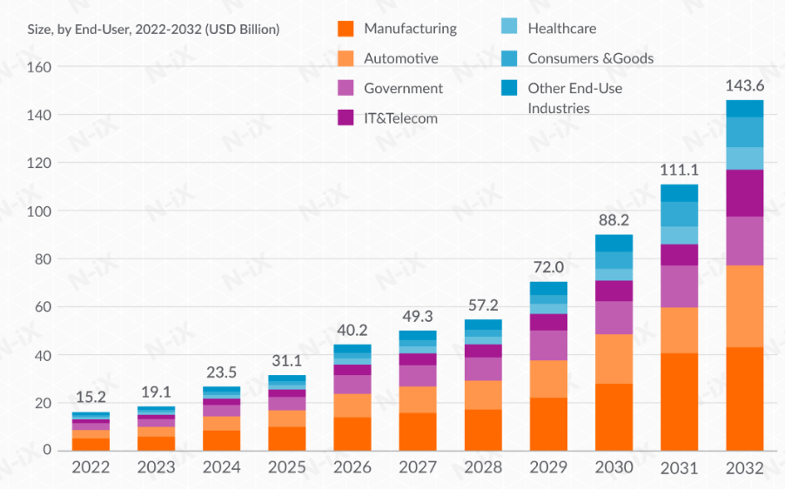
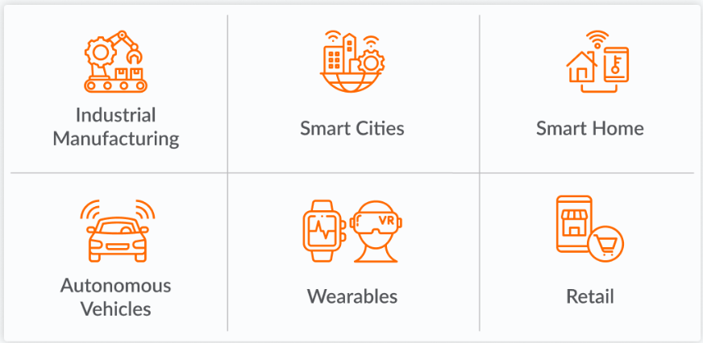
Trends in IoT Data Analysis
1. AI and ML enable intelligent IoT systems
2. Edge AI improves IoT performance

Slide 12
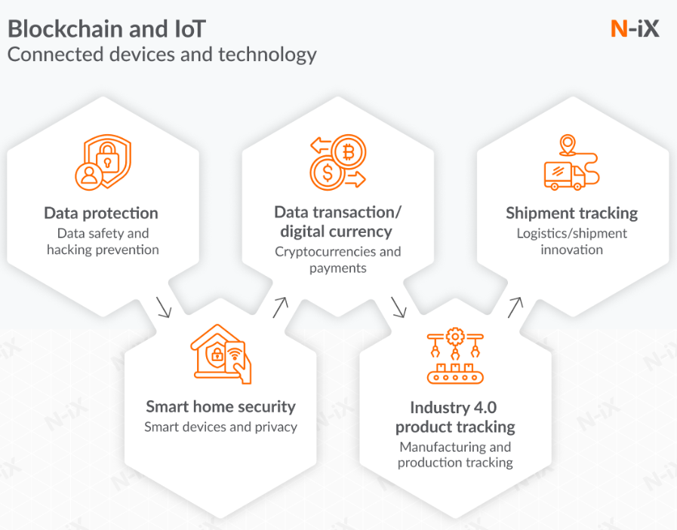
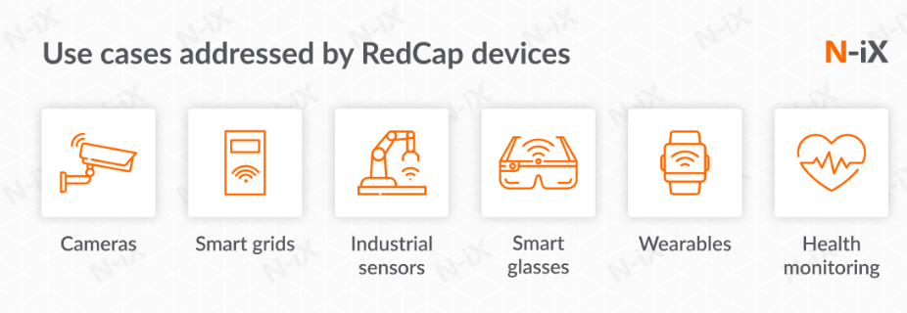
Trends in IoT Data Analysis
3. Increased focus on privacy and security
4. 5G networks fuel the growth of IoT

Slide 13
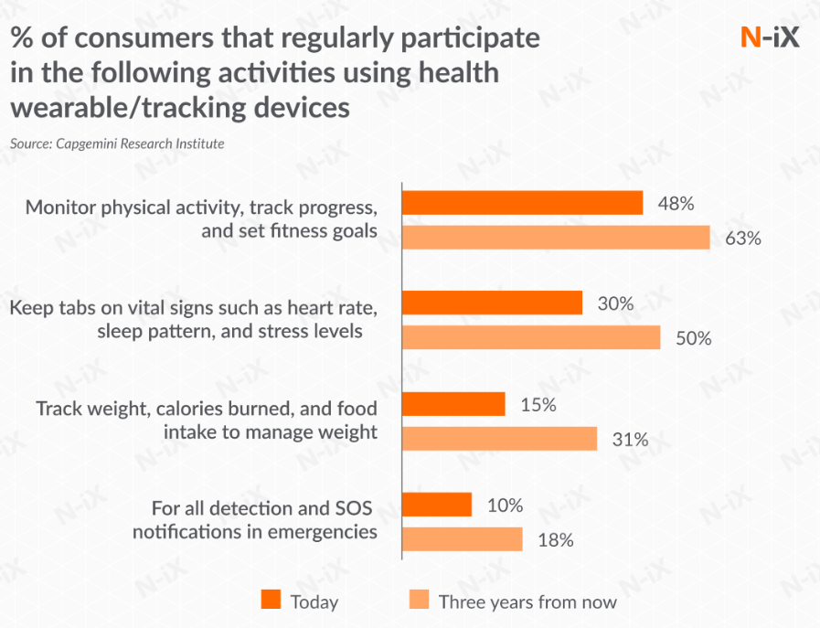
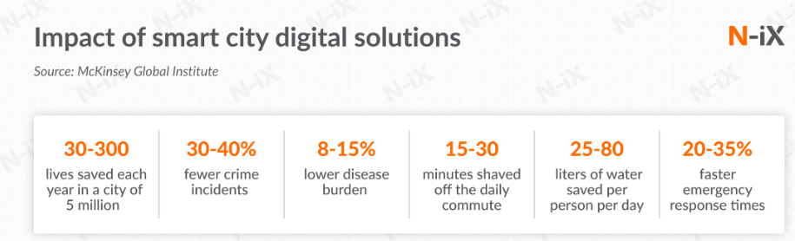
Trends in IoT Data Analysis
6. The adoption of wearables and voice assistants is on the rise
5. Smart cities are a growing trend

Slide 14
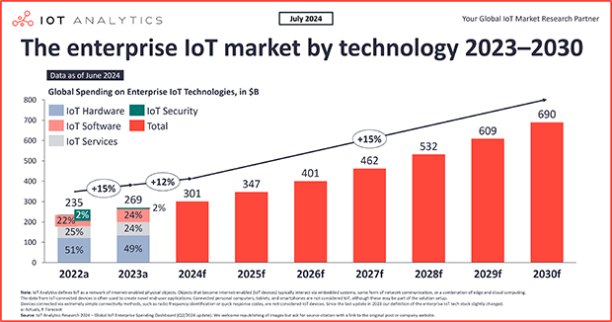

Slide 15
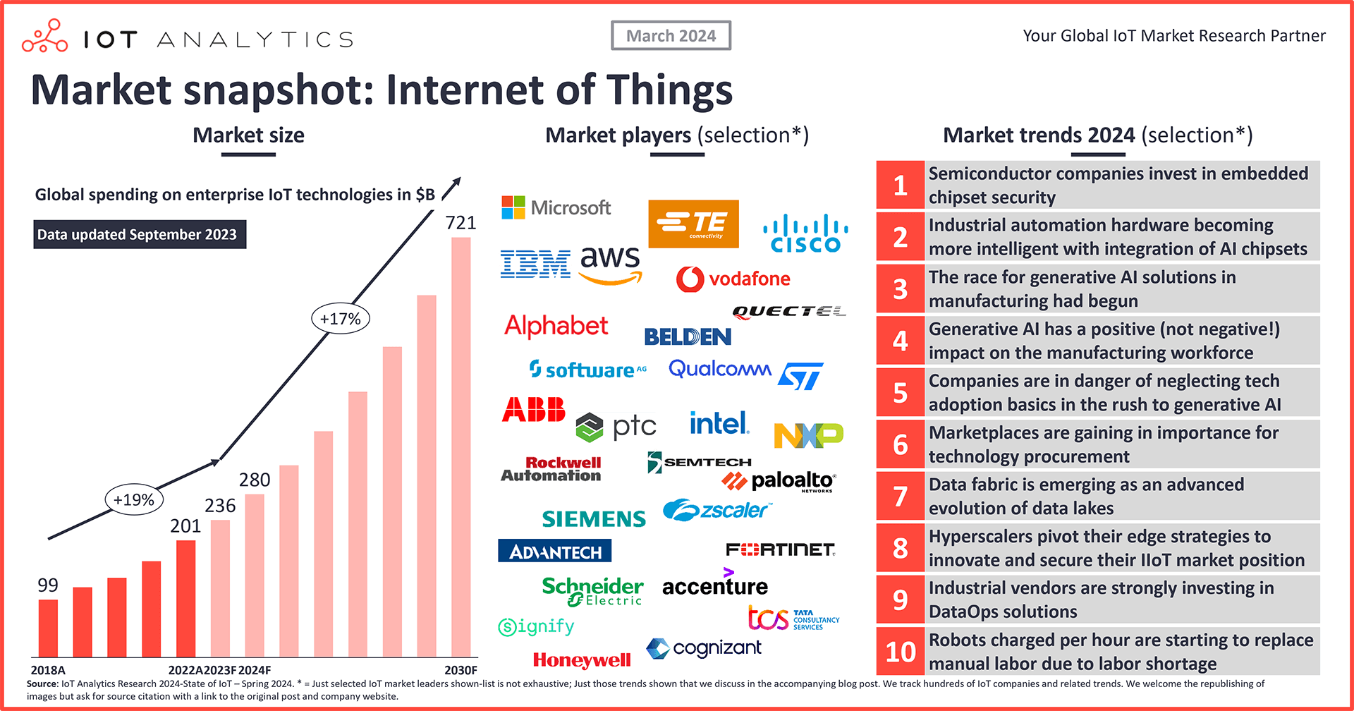

Slide 16
Conclusion
Summary: Data analysis is a key driver behind the success of IoT, helping organizations make data-driven decisions, optimize processes, and predict future trends.
Future Impact: As IoT and data analytics technologies evolve, they will continue to revolutionize industries, leading to smarter and more efficient systems.
Closing Statement: IoT and data analytics together hold the potential to shape the future of connected, intelligent ecosystems.

Slide 17


Slide 18


